Slide 2
Image formatting process
Image is combo of 3 signals
Auto Fluorescence
Solution fluorescence
Stain signal fluorescence
Goal is to separate signal F from the rest.
Auto is found as a before stain is applied image at same settings
Solution is found by subtracting a scaled auto image until it effectively disappears in first time frame of stain kinetics
Signal F is found by subtracting the scaled auto and solution image from kinetic images
Note, solution intensity changes over time. I can sub sample a region in the solution image and it is reflective of rough overall fluorescence change in it as indicated by two regions giving very similar scaling ratios over time. To compensate, the solution image is multiplied by the ratio at the time point before being subtracted from total image.

Slide 3
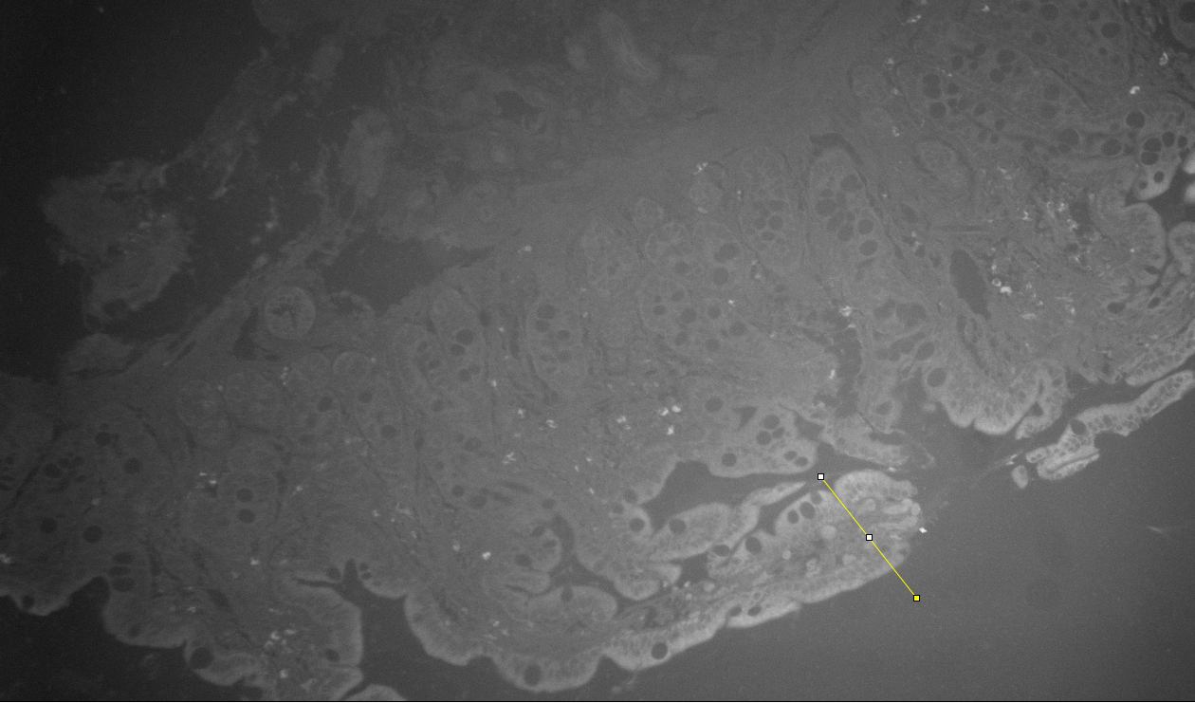
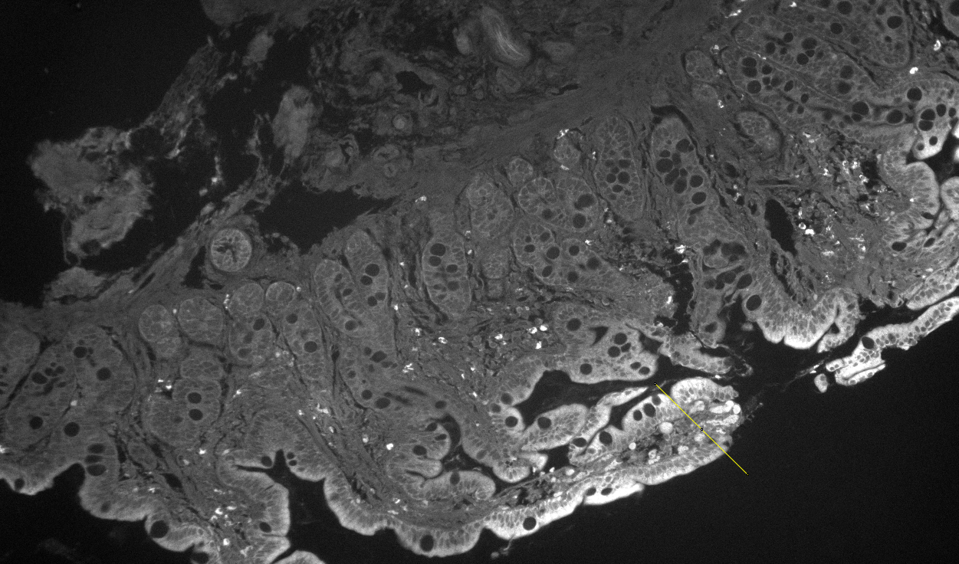
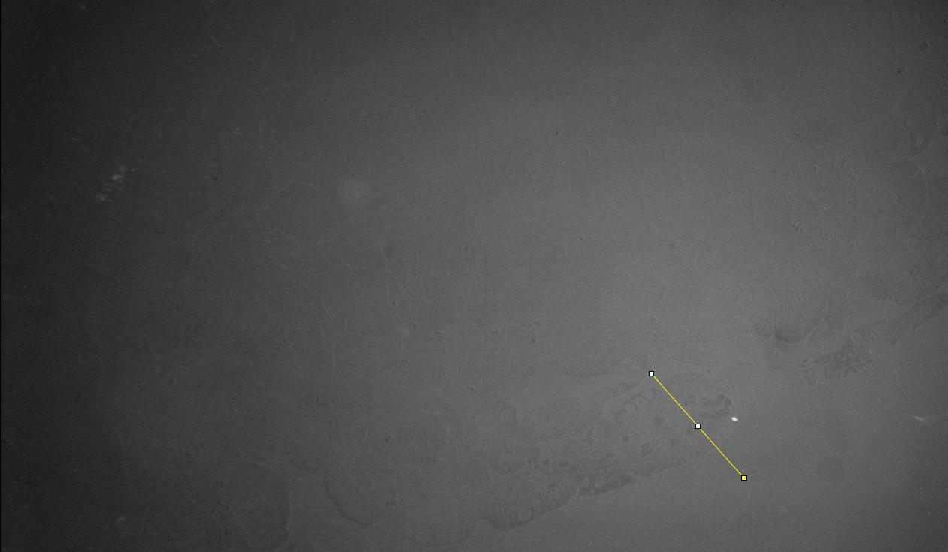
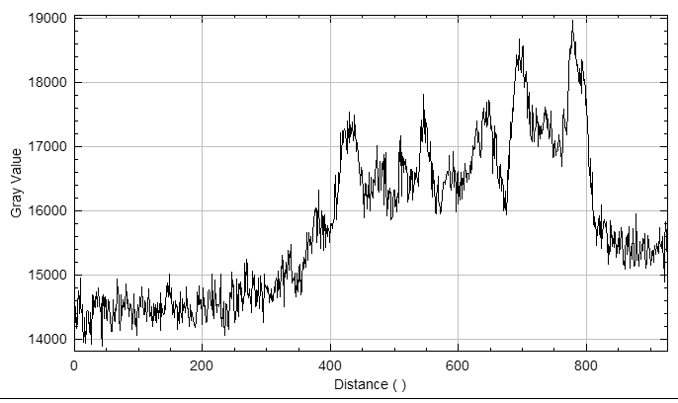
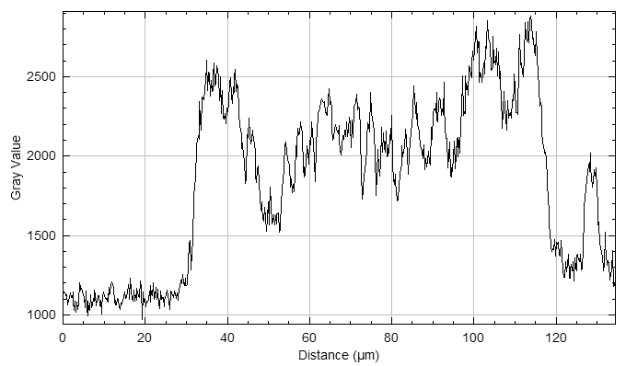
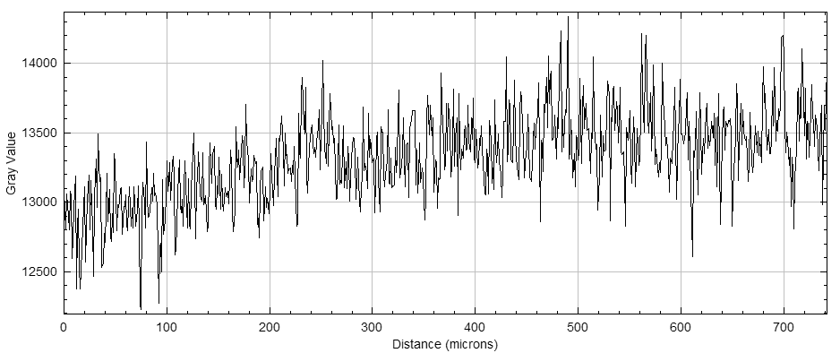
Subbing off auto fluorescence and determing solution fluorescence

Slide 4
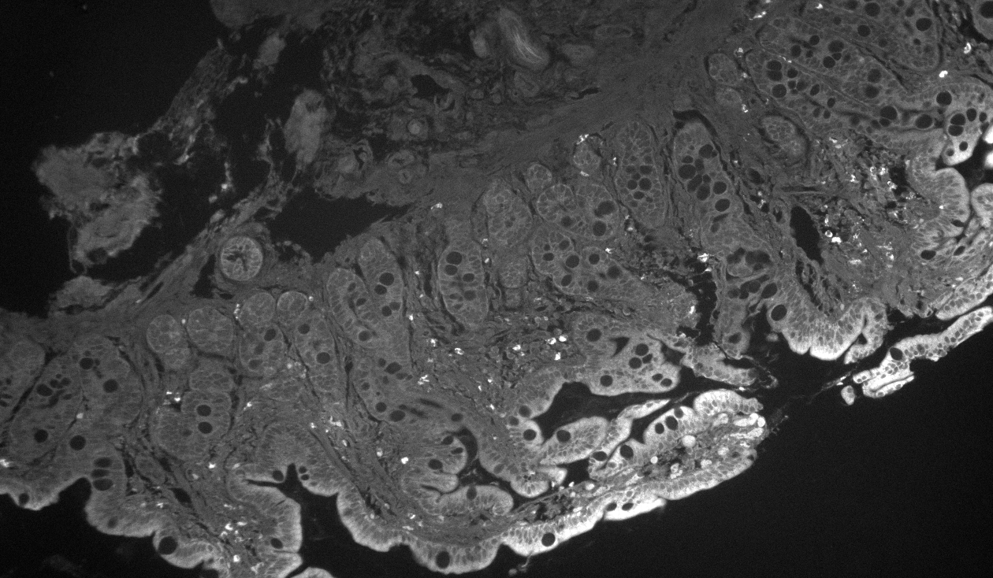
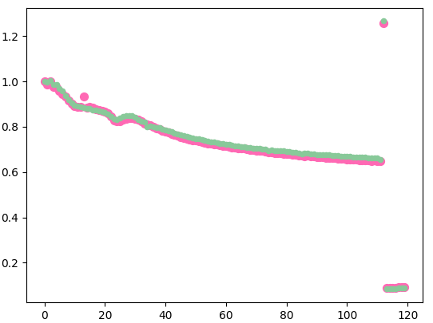
Scaling of fluorescence in solution
Scale solution fluorescence over time via normalized ratio in pink box.

Slide 5
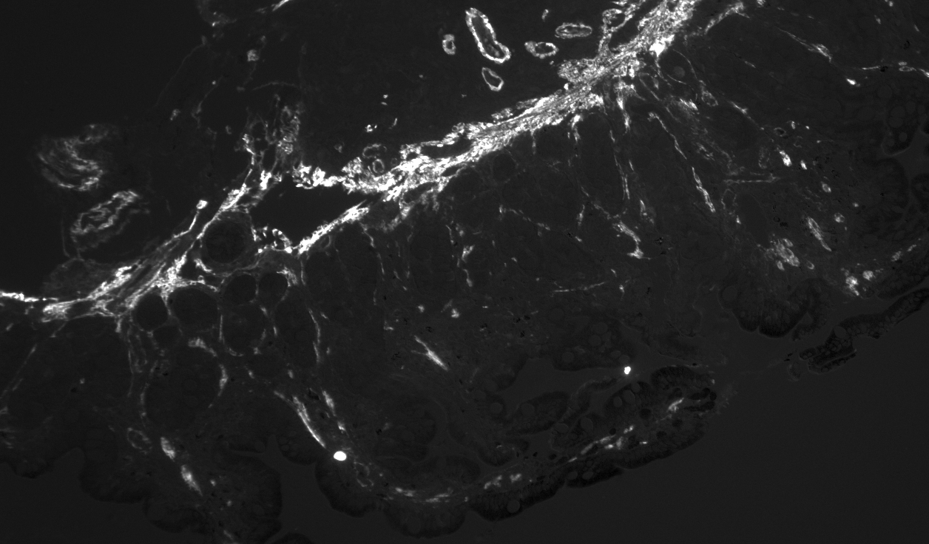
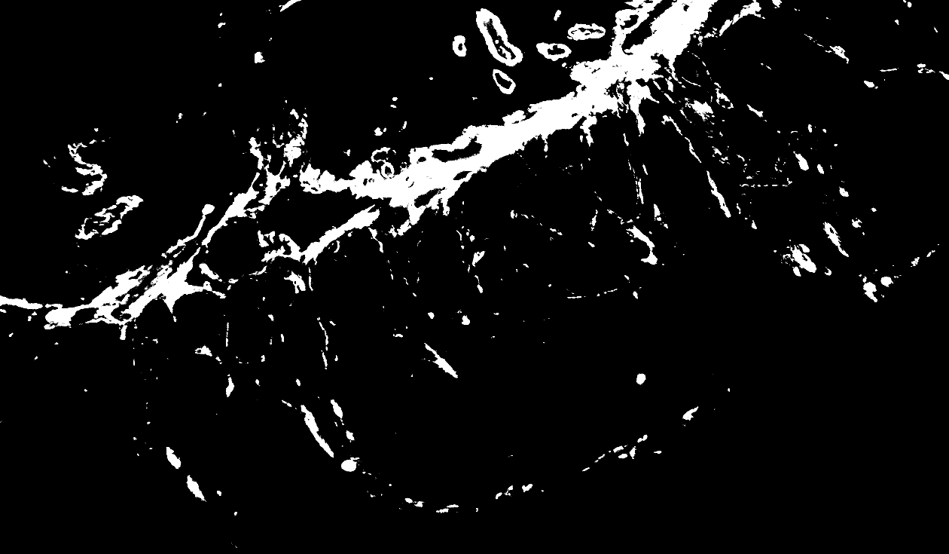
Mask

Slide 6
Summary Equation
Solution F = first frame – C*auto F image until tissue disappears in it
Signal F = Kinetics Raw image – C*auto F – scaled solution
Analyzed intensity = sum(signal F image * mask)

Slide 7
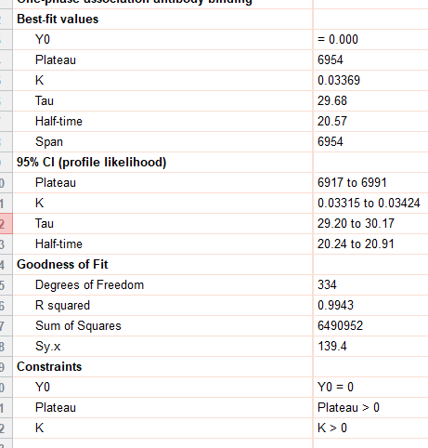
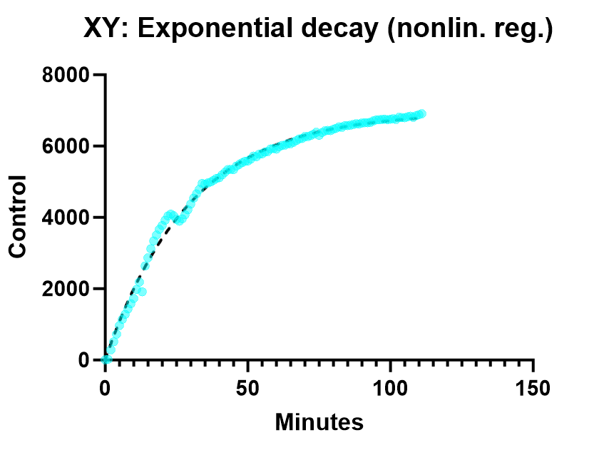
Intensity per pixel

Slide 8
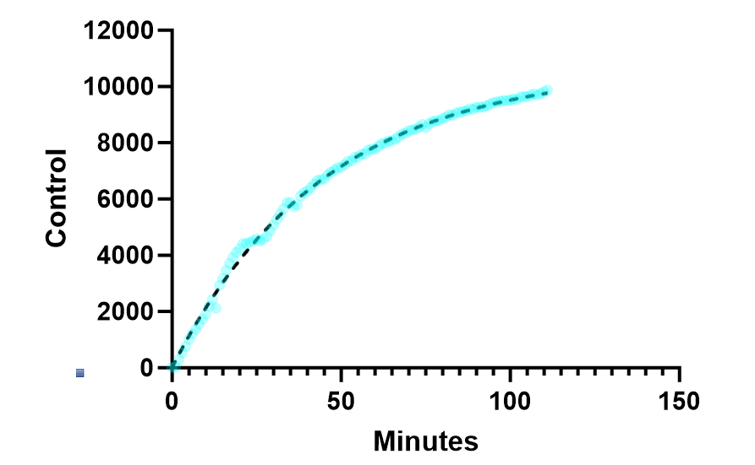
Unsure Consideration?
Compensated R = .9975
I separated the signal F from everything else, but solution F indicated that non-trivial bleaching was occurring.
Possible solution is to say I need to divide signal F by the decay curve to compensate.
Appears model fits this form of data better than non compensated version.
Non-Compensated R= 0.9943

